Slide 1
Introduction to C++
CDAC Mumbai

Slide 2
The purpose in learning C++ is not simply to learn a new syntax for doing things the way you used to, but to learn new and better ways of building systems.
This has to be done gradually because acquiring any significant new skill takes time and requires practice.

Slide 3
Philosophical Note
A programming language serves two related purposes: it provides a vehicle for the programmer to specify actions to be executed, and it provides a set of concepts for the programmer to use when thinking about what can be done. The first purpose ideally requires a language that is ‘‘close to the machine’’ so that all important aspects of a machine are handled simply and efficiently in a way that is reasonably obvious to the programmer. The C language was primarily designed with this in mind. The second purpose ideally requires a language that is ‘‘close to the problem to be solved’’ so that the concepts of a solution can be expressed directly and concisely. The facilities added to C to create C++ were primarily designed with this in mind.

Slide 4
History
Inspired from a language SIMULA 67 used for Simulation, regarded as the first language to support the object-oriented programming paradigm.
The goal was to add object-oriented programming into the C language, which was and still is a language well-respected for its portability without sacrificing speed or low-level functionality
C++ also Known as C with Classes designed by Bjarne Stroustrup in 1987

Slide 5
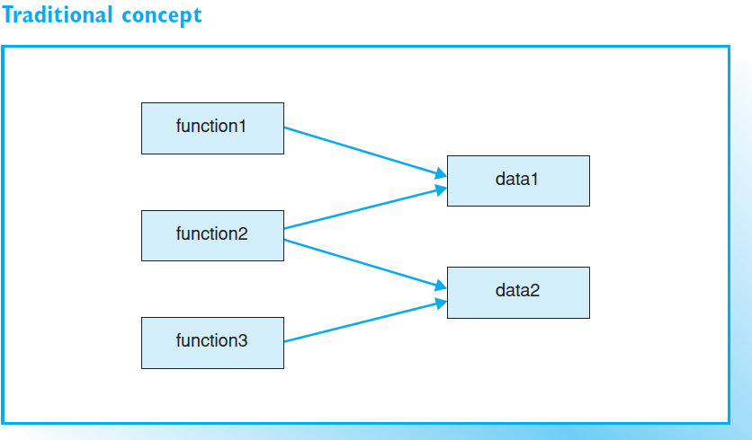
Procedure-ORIENTED-PROGRAMMING(POP)

Slide 6
Object Oriented Programming (OOP)
Object A Object B
Object C
Data
Data
Functions
Functions
Functions
Data

Slide 7
Procedure oriented programming Vs Object oriented programming
POP
OOP
Emphasis is on Procedure
Programs are divided into functions
Most of the functions share global data
Data move openly around the system from function to function
Employs top down approach
Emphasis is on data
Programs are divided into objects
Functions that operate on the data of an object are tied together in the data structure
Data is hidden and cannot be accessed by external functions.
Employs bottom up approach

Slide 8
C++ supports the concepts of object-oriented programming (or OOP for short), which are:
data abstraction, that is, the creation of classes to describe objects
data encapsulation for controlled access to object data
inheritance by creating derived classes (including multiple derived classes)
polymorphism (Greek for multiform), that is, the implementation of instructions that can have varying effects during program execution.
reusability i.e Once a class has been written, completed and tested, it can be distributed to other programmers for use in their own programs.

Slide 9
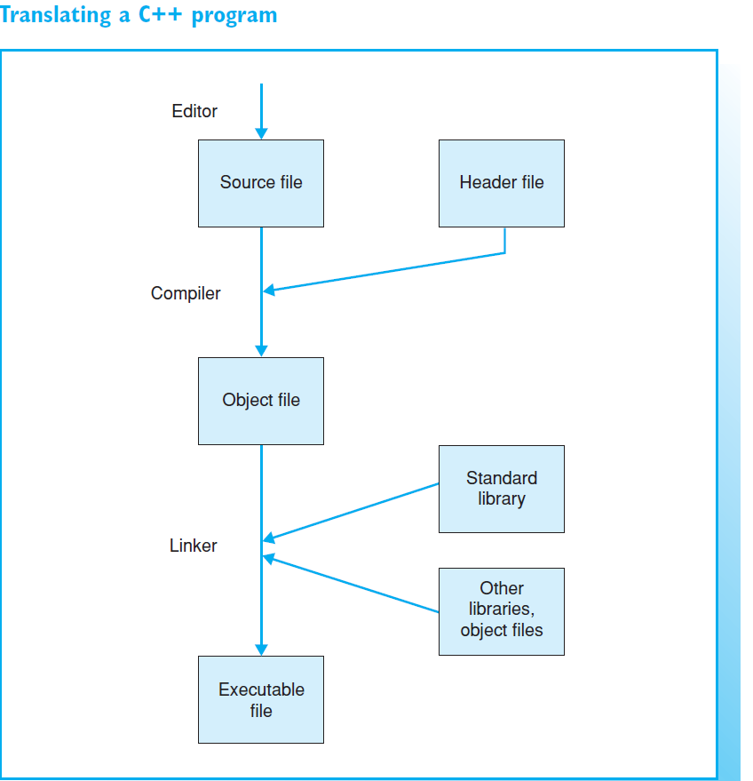

Slide 10
Objects
Objects are the basic run time entities in an object oriented system.
Objects are of two types: Real world objects and logical (software) objects
It may represent a person, a place, a bank account, or user defined data such as vectors , time and lists.
Real world Objects share two characteristics : State and behavior
Software objects are modeled after real world in that they too have state and behavior
It maintains its state in one or more variables(data)
A software objects implements its behavior with methods.
A method is a function (subroutine) associated with an object.

Slide 11
Objects
Thus, Each object contain data and code to manipulate the data .
Object can be interacted without knowing the details of data or code.
It is sufficient to know the type of message accepted and the type of response returned by the objects.
Objects may communicate with each other through functions.
Object are instances/variables of type class

Slide 12
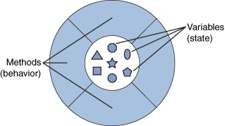
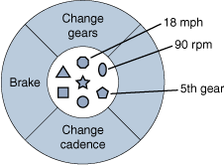
Definition of an object
An object is a software bundle of variable and related methods
A software object.
A bicycle modeled as a software object

Slide 13
Classes
Objects are variables of type class
In Real world, we have many objects of the same kind, e.g. bicycles, monitors, cars, pens, keyboards ,etc.
Hence your bicycle is an Instance/Variable of the class of objects known as bicycles.
Objects have some state and behavior. However, each object’s state is independent of and can be different from other objects of that class bicycles.
A class is thus collection of objects of similar type
When an instance of a class is created, the system allocates enough memory for that object and all its instance variables.
Each instance gets its own copy of all variables define in the class, as the figure below shows.

Slide 14
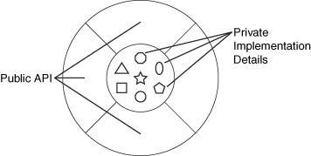
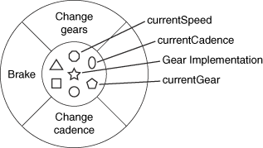
A visual representation of a class
Bicycle Class

Slide 15
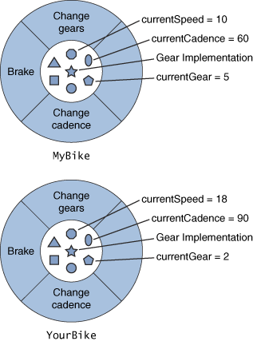

Slide 16
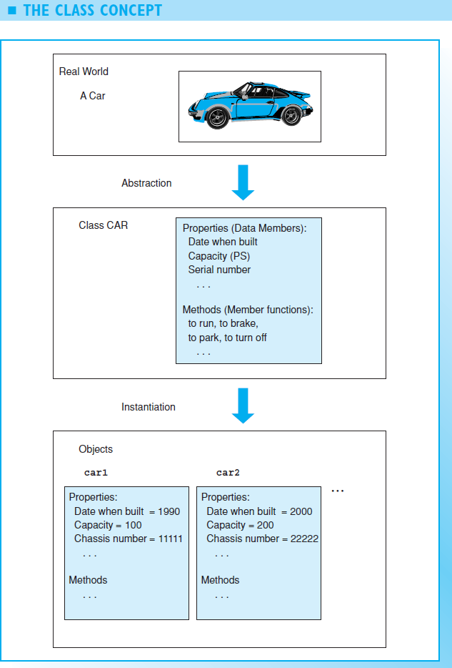

Slide 17
Classes
General form of class declaration that does not inherit any class.
Class class-name {
private data and functions
access-specifier :
data and functions
//…
access-specifier :
data and functions
} object-list;
Notes:
data and the function are private by default in the class declaration, ie the data is not visible to outside world, ie. updation to the data can't be done .
class-name : user-defined data type.
whereas object-list is the instance of the class-name. ie memory is allocated.

Slide 18
Classes
The object-list is optional. If present, it declares object of the class.
The access-specifier is one of these three C++ keywords:
1. Public
2. Private
3. Protected
By default, functions and data declared within a class are private to that class and can be accessed only by other members of that class.
The public access specifier allows functions or data to be accessible to other parts of your program.
The protected access specifier is needed only when inheritance is involved.

Slide 19
Data Encapsulation
The Wrapping up of data and functions into a single unit is called Encapsulation.
The data is accessible only to the functions which are wrapped in the class, and not to the external world.
These functions provide the interface between the object’s data and the program.
The insulation of data from direct access by the program is called data hiding.

Slide 20
Benefits of Encapsulation
Encapsulating related variable and methods into a neat software bundle is a simple but yet powerful idea which allows
a) Modularity: The source for an object can be written and maintained independently of the source code for other objects. Also, an object can be easily passed around the system.
E.g You can give your bicycle to someone else, and it will still work.
b) Information-hiding: An object has a public interface that other objects can use to communicate with. The object can maintain private information and methods that can be changed at any time without affecting other objects that depend on it.
E.g You don’t need to understand a bike’s gear mechanism to use it.

Slide 21
Data Abstraction
Abstraction refers to the act of representing essential features without including the background details
Classes use the concept of abstraction and are defined as a list of abstract attributes , and the function to operate on these attributes.
The classes use the concept of data abstraction, hence they are known as Abstract data types(ADT).

Slide 22
Inheritance
Inheritance is the process by which objects of one class can acquire the properties of objects of another class.
New classes can be built from the old one. The new class referred to as derived class / inherited / sub / child class, can inherit the data structure and functions of the original class called as base class / super class / parent class.

Slide 23
Inheritance
The concept of inheritance provides the idea of reusability.
Additional features can be added to an existing class without modifying it. This is done by deriving a new class (derived class) from the existing one (base class).
Base
Derived

Slide 24
Polymorphism
Polymorphism means the ability to take more than one form.
Operator Overloading and Function Overloading
eg., Operation may exhibit different behaviour in different instances.
Consider the operation of addition, and two data types int and string.
1. For two numbers, the operation will generate a sum.
2. If the operands are strings, then the operation would
be third string by concatenation.
Notes:
polymorphism is said to be " one interface, multiple methods "
for eg : operator overloading & function overloading .
The same operator can be used at different situation.
a * b; // * muliply operator
int *p // * pointer operator
cout << x; // << insertion operator
z = x << 3; // << the x is left shifted by three bit and stored in z.

Slide 25
Polymorphism
Shape
Draw()
Circle
Object
Box
Object
Triangle
Object
Draw(circle)
Draw(Box)
Draw(triangle

Slide 26
Advantages of C++
New programs would be developed in less time because old code can be reused.
Creating and using new data types would be easier than in C.
The memory management under C++ would be easier and more transparent.
Programs would be less bug-prone, as C++ uses a stricter syntax and type checking.
“Data hiding”, implementation is easy in C++.
Notes:
1. Once the class is is established, if we want the same class with few more features, then we can define a new class which can derive the features of the old class.
2. The goal of the class creator is to build a class that exposes only what’s necessary to the client programmer and keeps everything else hidden., the client programmer can’t use it, which means that the class creator can change the hidden portion at will without worrying about the impact to anyone else. The hidden portion usually represents the tender insides of an object that could easily be corrupted by a careless or uninformed client programmer, so hiding the implementation reduces program bugs.

